Slide 1
Course Introduction
Advanced Statistical Analyses in Natural Resource Sciences (NRES 776)
Instructor: Heather Bryan
Sept 9, 2021

Slide 2
Agenda for Today
Introductions
About the course
Assignments

Slide 3
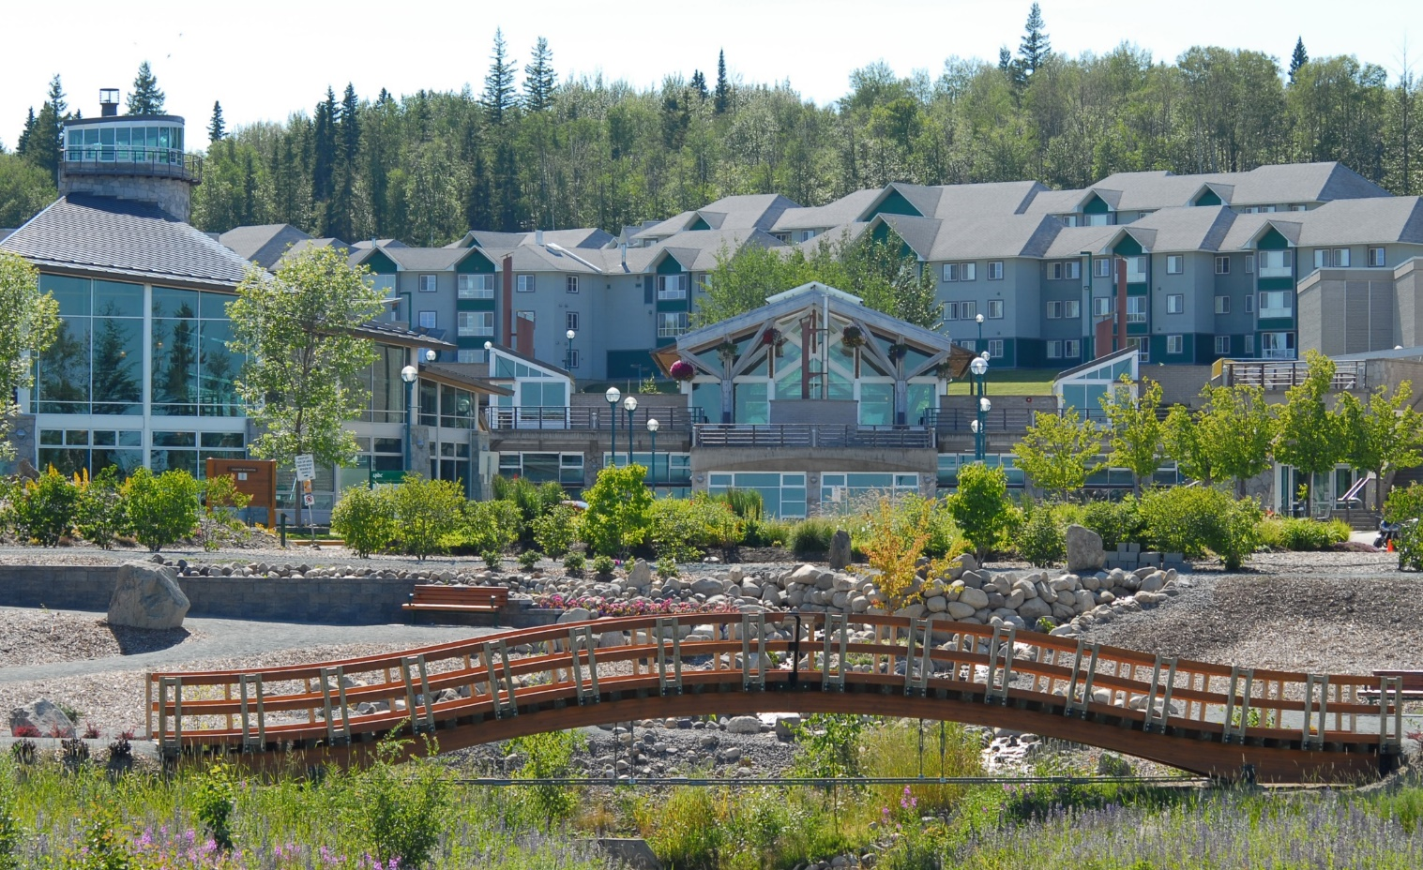
Territorial acknowledgement
UNBC is located on the unceded territory of the Leidhli T’enneh Nation
Notes:
-why this matters in statistics
-ask students to type in chat whose territory they are on
-matters in statistics because most environmental data collected on Indigenous lands, statistics can be a powerful way to summarize and learn about data, but rooted in Western Science so can be interpreted out of context
-need to try and bridge
-big topic, will be exploring in discussion period

Slide 4
Introductions
Name, program, research topic and type of data/analyses, what you hope to gain from the course

Slide 5

What this course is (& isn’t)
Intermediate level of statistics
Applied, project-based
Develop skills in coding
Discuss key issues in statistics
Not an advanced modeling course

Slide 6
Course format
Will attempt synchronous lectures & will record them
Will incorporate problems & examples (also a focus of the lab)
Labs: R Tutorial & weekly discussion (Synchronous), and exercises
Office hours: T and Th 2:30-3:30 in Collaborate

Slide 7
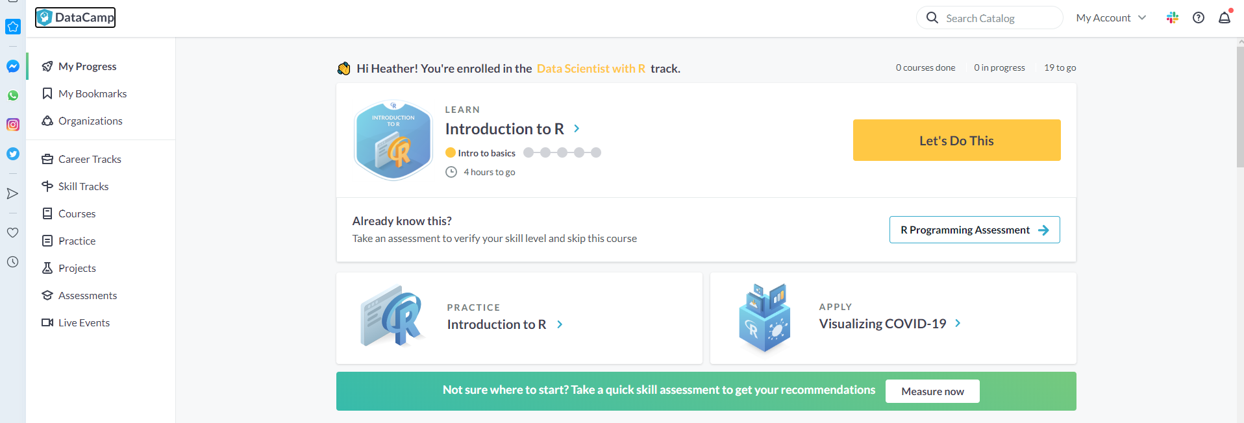
DataCamp
Interactive R tutorials
Free access for this class
Will provide invitation link
I would appreciate your feedback!

Slide 8
Assessments
Project 1
data exploration, display, and limitations, simple statistical analysis from labs 1-6

Slide 9
Assessments
Project 1
data exploration, display, and limitations, simple statistical analysis from labs 1-6
Format (60 points, 30% of grade)
Background and research question
Hypothesis and predictions
Description of data and approach
Analysis
Limitations of data
Graphical Abstract
Due Dates
Oct 13: data set, hypotheses, research question
Oct 20: Project outline and analytical approach
Oct 27: First draft (peer review)
Nov 3: Final report and graphical abstracts due (present to class)

Slide 10
Assessments
Project 1
data exploration, display, and limitations, simple statistical analysis from labs 1-6
Format (60 points, 30% of grade)
Background and research question
Hypothesis and predictions
Description of data and approach
Analysis
Limitations of data
Graphical Abstract
Due Dates
Oct 13: data set, hypotheses, research question
Oct 20: Project outline and analytical approach
Oct 27: First draft (peer review)
Nov 3: Final report and graphical abstracts due (present to class)

Slide 11
Assessments
Project 2
Scientific publication, analyses from labs 7-12

Slide 12
Assessments
Project 2
Scientific publication, analyses from labs 7-12
Format (100 points, 40% of grade)
Title & abstract
Introduction
Methods
Results
Discussion and literature cited
Powerpoint presentation
R Code as Appendix

Slide 13
Assessments
Project 2
Scientific publication, analyses from labs 7-12
Format (100 points, 40% of grade)
Title & abstract
Introduction
Methods
Results
Discussion and literature cited
Powerpoint presentation
R Code as Appendix
Due Dates
Nov 17: data set, hypotheses, research question
Nov 24: Project outline and analytical approach
Dec 1: First draft and Presentations (peer review)
Dec 6: Final report and graphical abstracts due (present to class)

Slide 14
Data Sources
Own data
Lab data
Published data
Ecological Data Wiki
http://ecologicaldata.org/
Ecological Society of America Data Registry
http://data.esa.org/esa/style/skins/esa/index.jsp
DRYAD
http://www.datadryad.org/
LTER: Long Term Ecological Research network
http://metacat.lternet.edu/das/lter/index.jsp
Data lists
NCEAS: Ecological and spatial data sources
https://www.nceas.ucsb.edu/scicomp/data
UC Berkeley: Data repositories
http://www.lib.berkeley.edu/BIOS/data_environment.html
Duke University: Data repositories
http://guides.library.duke.edu/content.php?pid=177435&sid=1709958

Slide 15
Selecting Data
Simple data will not be easy data to use
Big (but not too big)
Clear question in mind?
Scientific hypothesis
Model testing
Incorporate real sampling or experimental design constraints
Incorporate multiple variables
Time invested in getting good data will pay large dividends later

Slide 16
Discussion Papers
Two/week, will send link to sign up in Blackboard
10% of grade for leading a discussion (in pairs)
Should start with brief (10-15 min) summary of the topic
Balance enough detail without going into too much
May need to refer to other literature for context
Have some discussion questions prepared to guide the class
You can decide on the format. For example, you could break the class into groups to answer specific questions, or have the whole class discuss the same questions. Feel free to talk with me about ideas!
Here are some useful tips on leading a discussion: http://baumlab.weebly.com/uploads/1/2/4/4/12445281/462_2016_tutorial1_howtoleaddiscussion.pdf
First discussion Wednesday on Reproducible code

Slide 17
Take-home exam
Open book, independent
Will cover all topics from labs
Will have to analyze some data sets
20% of grade
Available Dec 9, due Dec 16 at 5:00 pm

Slide 18
Online Learning
Classroom tour
Tips & Tricks
Suggestions

Slide 19
Lab Next Week
Wednesday at 11:30 am
Discussion (Volunteers?)
1. Data Management and Reproducibility
Stodden et al. 2018. Journal policy for computational reproducibility. PNAS
2. Alston et al. 2020. A Beginner's Guide to Conducting Reproducible Research. Bull Ecol Soc Am 102( 2):e01801.
Download R Studio ahead of time
R Studio Intro Video
Learning how to Code Articles
Introduction to R Tutorial in Datacamp

